Slide 1
Sports Marketing
Standard 1.2
Marketing Of Sports

Slide 2
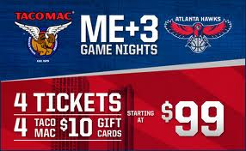
Objective Two
Identify reasons a sports property would utilize marketing

Slide 3
What IS Sports Marketing
Sports Marketing is the application of marketing principles to sports properties and to non-sports products using sports.
Simply:
Sports Marketing is the Marketing of Sports
Sports Marketing is Marketing Through Sports
Notes:
1

Slide 4
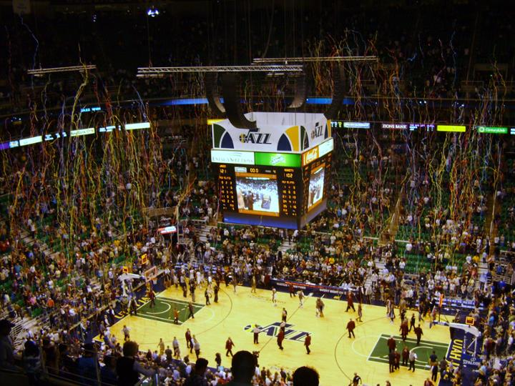
Marketing OF Sports
Applying marketing Principles to the marketing of a “Sports Property”
Sports Properties:
League Team
Athlete Stadium Arena
Program Event Meet
Competition Contest
Notes:
10. 11

Slide 5
Marketing OF Sports
Athletes
Agents
Ticket Sales Representative
Ticket Collection
Marketing Writers
Sports Journalist
Parking
Merchandise Vendor
Director of Marketing
Sponsorship Sales Executive
Director of Communications
Security
Maintenance
Concessions
Sports Announcer
Notes:
Agents #21

Slide 6
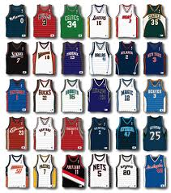
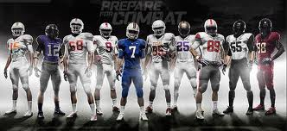
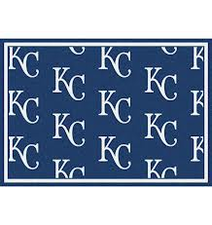
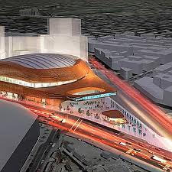
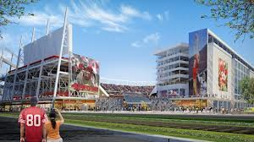
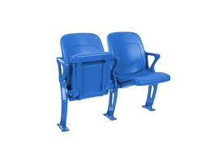
Marketing of SPORTS

Slide 7
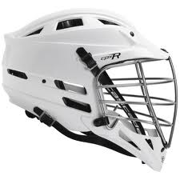
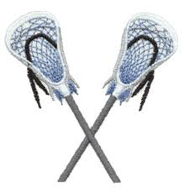
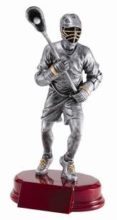
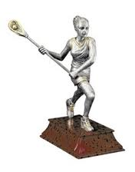
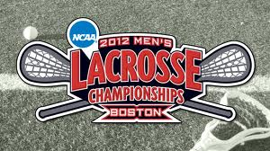
The Growth of Lacrosse

