Slide 1
Lesson 13: Managing Change
“We must always change, renew, rejuvenate ourselves; otherwise we harden.” -Goethe

Slide 2
Change
We are all human ships on life’s ocean!
Why does the wind have to change?
Fact: We live in a world of constant change.
“There is a certain relief in change, even though it be from bad to worse! As I have often found in traveling in a stagecoach, that it is often a comfort to shift one’s position, and be bruised in a new place.”
-Washington Irving

Slide 3
1. Why are changes occurring?
Change is inevitable.
Basic condition of the world of work.
Technology, nature of work, and diversity.
Globalization: business expansion globally - including customers, suppliers and employees.
Increasing link between national and regional economies.
Changes resulting from mergers, takeovers, buyouts, downsizing, and acquisitions.

Slide 4
1. Why are changes occurring?
Nobody will function effectively without a capacity to plan and implement change.
Many changes are viewed as failures internally.
Use of inside task forces or outside consultants and specialists.
Initiated by top-level leaders.
Carried out by mid-level and first-line leaders.
Change means different attitudes and behaviors by the majority if not all employees.

Slide 5
2. What creates organizational change?
Change can be initiated from the inside or the outside.
New or existing leadership or new ideas from employees.
Change can result from customers or suppliers.
Also result from the organization’s environment.
Shifts in legal requirements, competitors. or market forces.
Involving employees is critical for success.

Slide 6
3. What happens as organizational change is implemented?
Change happens on three levels simultaneously.
Organization
Department, team or group
Individual
At organization level vision or image of change is required.
Resources like time and money are needed.
Across all divisions understanding what the change means is vital!

Slide 7
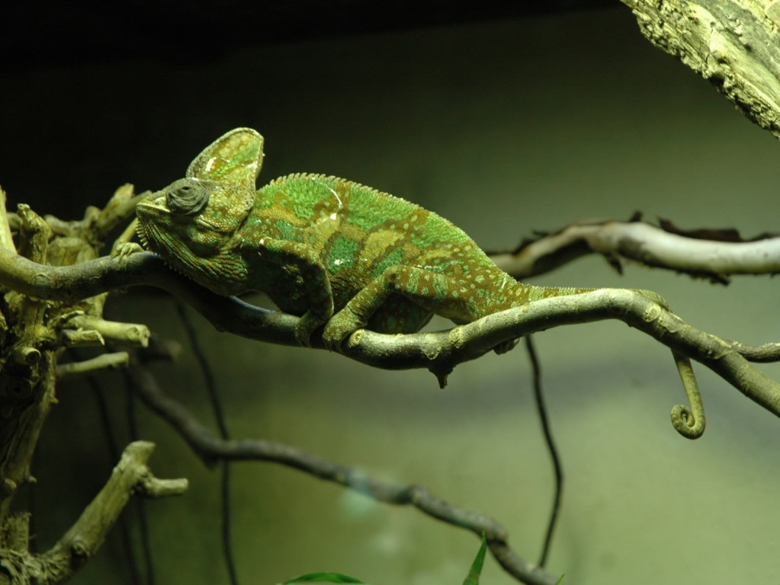
3. What happens as organizational change is implemented?
Individuals must adjust attitudes & behaviors, and be willing to change. (Chameleon)
Organizations must allocate resources.
These all require money and time.
Assign leaders to specific efforts.
Provide training to employees.
Communicating about the change.
Soliciting employee feedback.

Slide 8
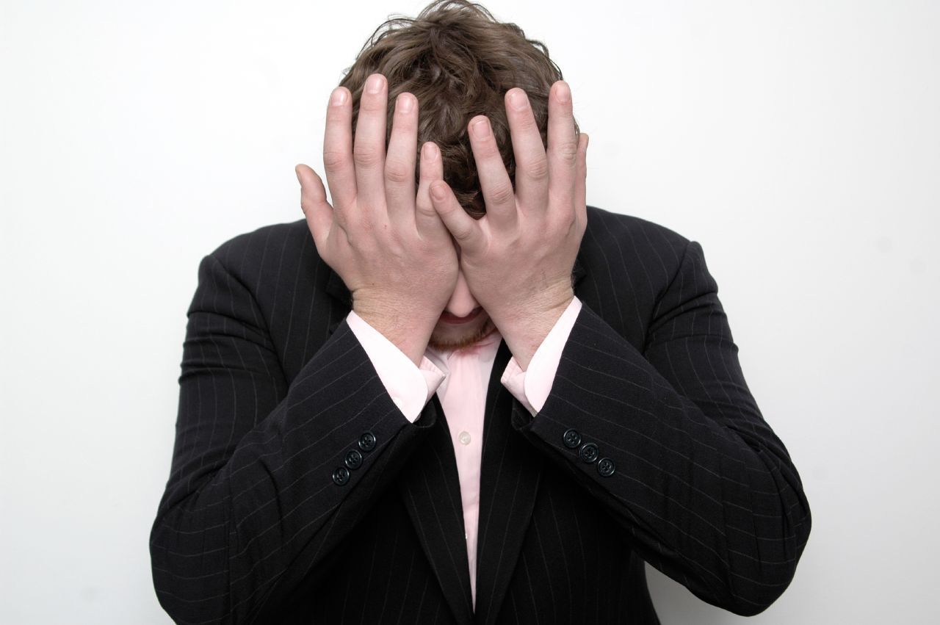
4. Why do people resist change?
People naturally resist change.
WHY?
Fear of unknown
Fear of power loss
Economic loss
Conflict of interest.
Fear of unknown exists when people are comfortable with the constant.
Can be perceived as potential personal loss.
Fear that change will create a loss of income.
Change threatens our present traditions, standards, values and norms.

Slide 9
5. How do leaders facilitate change?
Leadership support is critical for successful change.
Leaders must show why change is important.
Communication is the most important tool in facilitating change.
Employee participation.
Focus groups.
Establishing personal goals related to change.
Training.
Focus on benefits from changes.

Slide 10
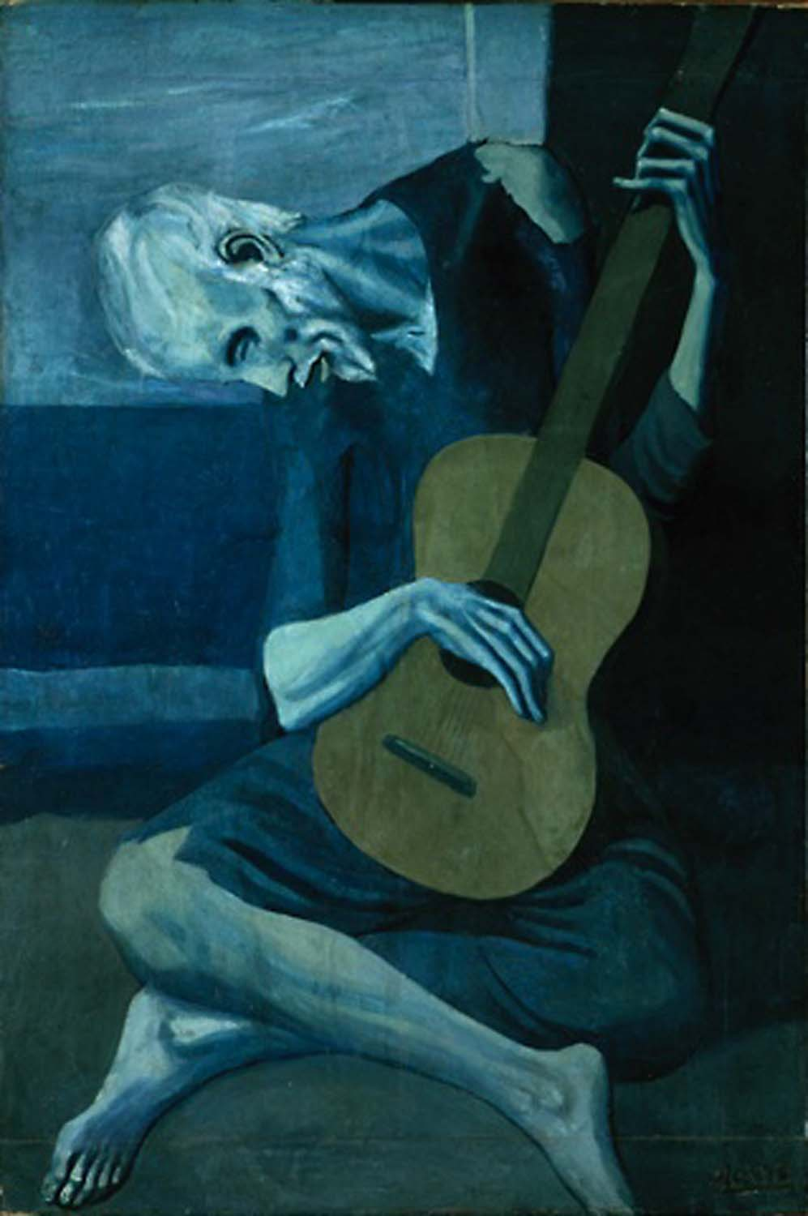
Picasso’s Example!
In his later years, Pablo Picasso was not allowed to roam an art gallery unattended, for he had previously been discovered in the act of trying to improve on one of his old masterpieces.

